Slide 1
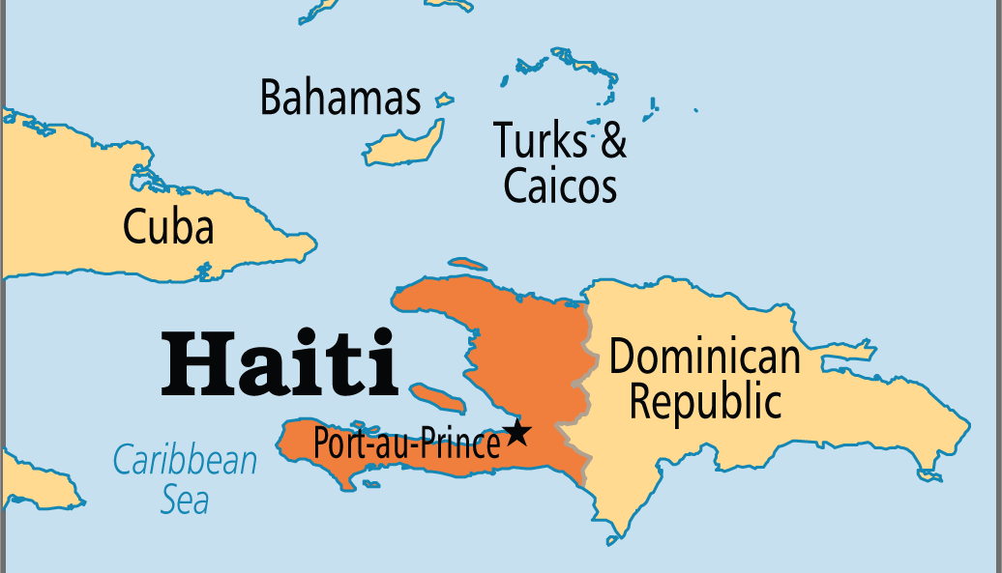

Slide 2
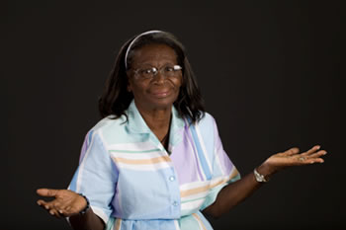
Marie’s House of grace, 1994
Marie Major

Slide 3
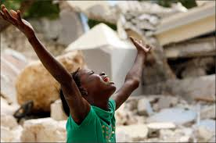
The earthquake HAPPENED in 2010.

Slide 4
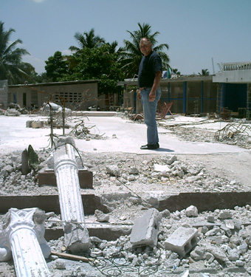
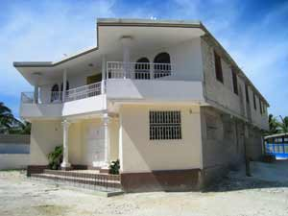
GRACE orphanage WAS destroyed ON January 12, 2010.

Slide 5

Grace missions INC. FORMED TO HELP
In 2013 Grace Missions Inc. became a registered 501(c) 3 non-profit Christian charitable organization incorporated in Barnesville, GA.

Slide 6
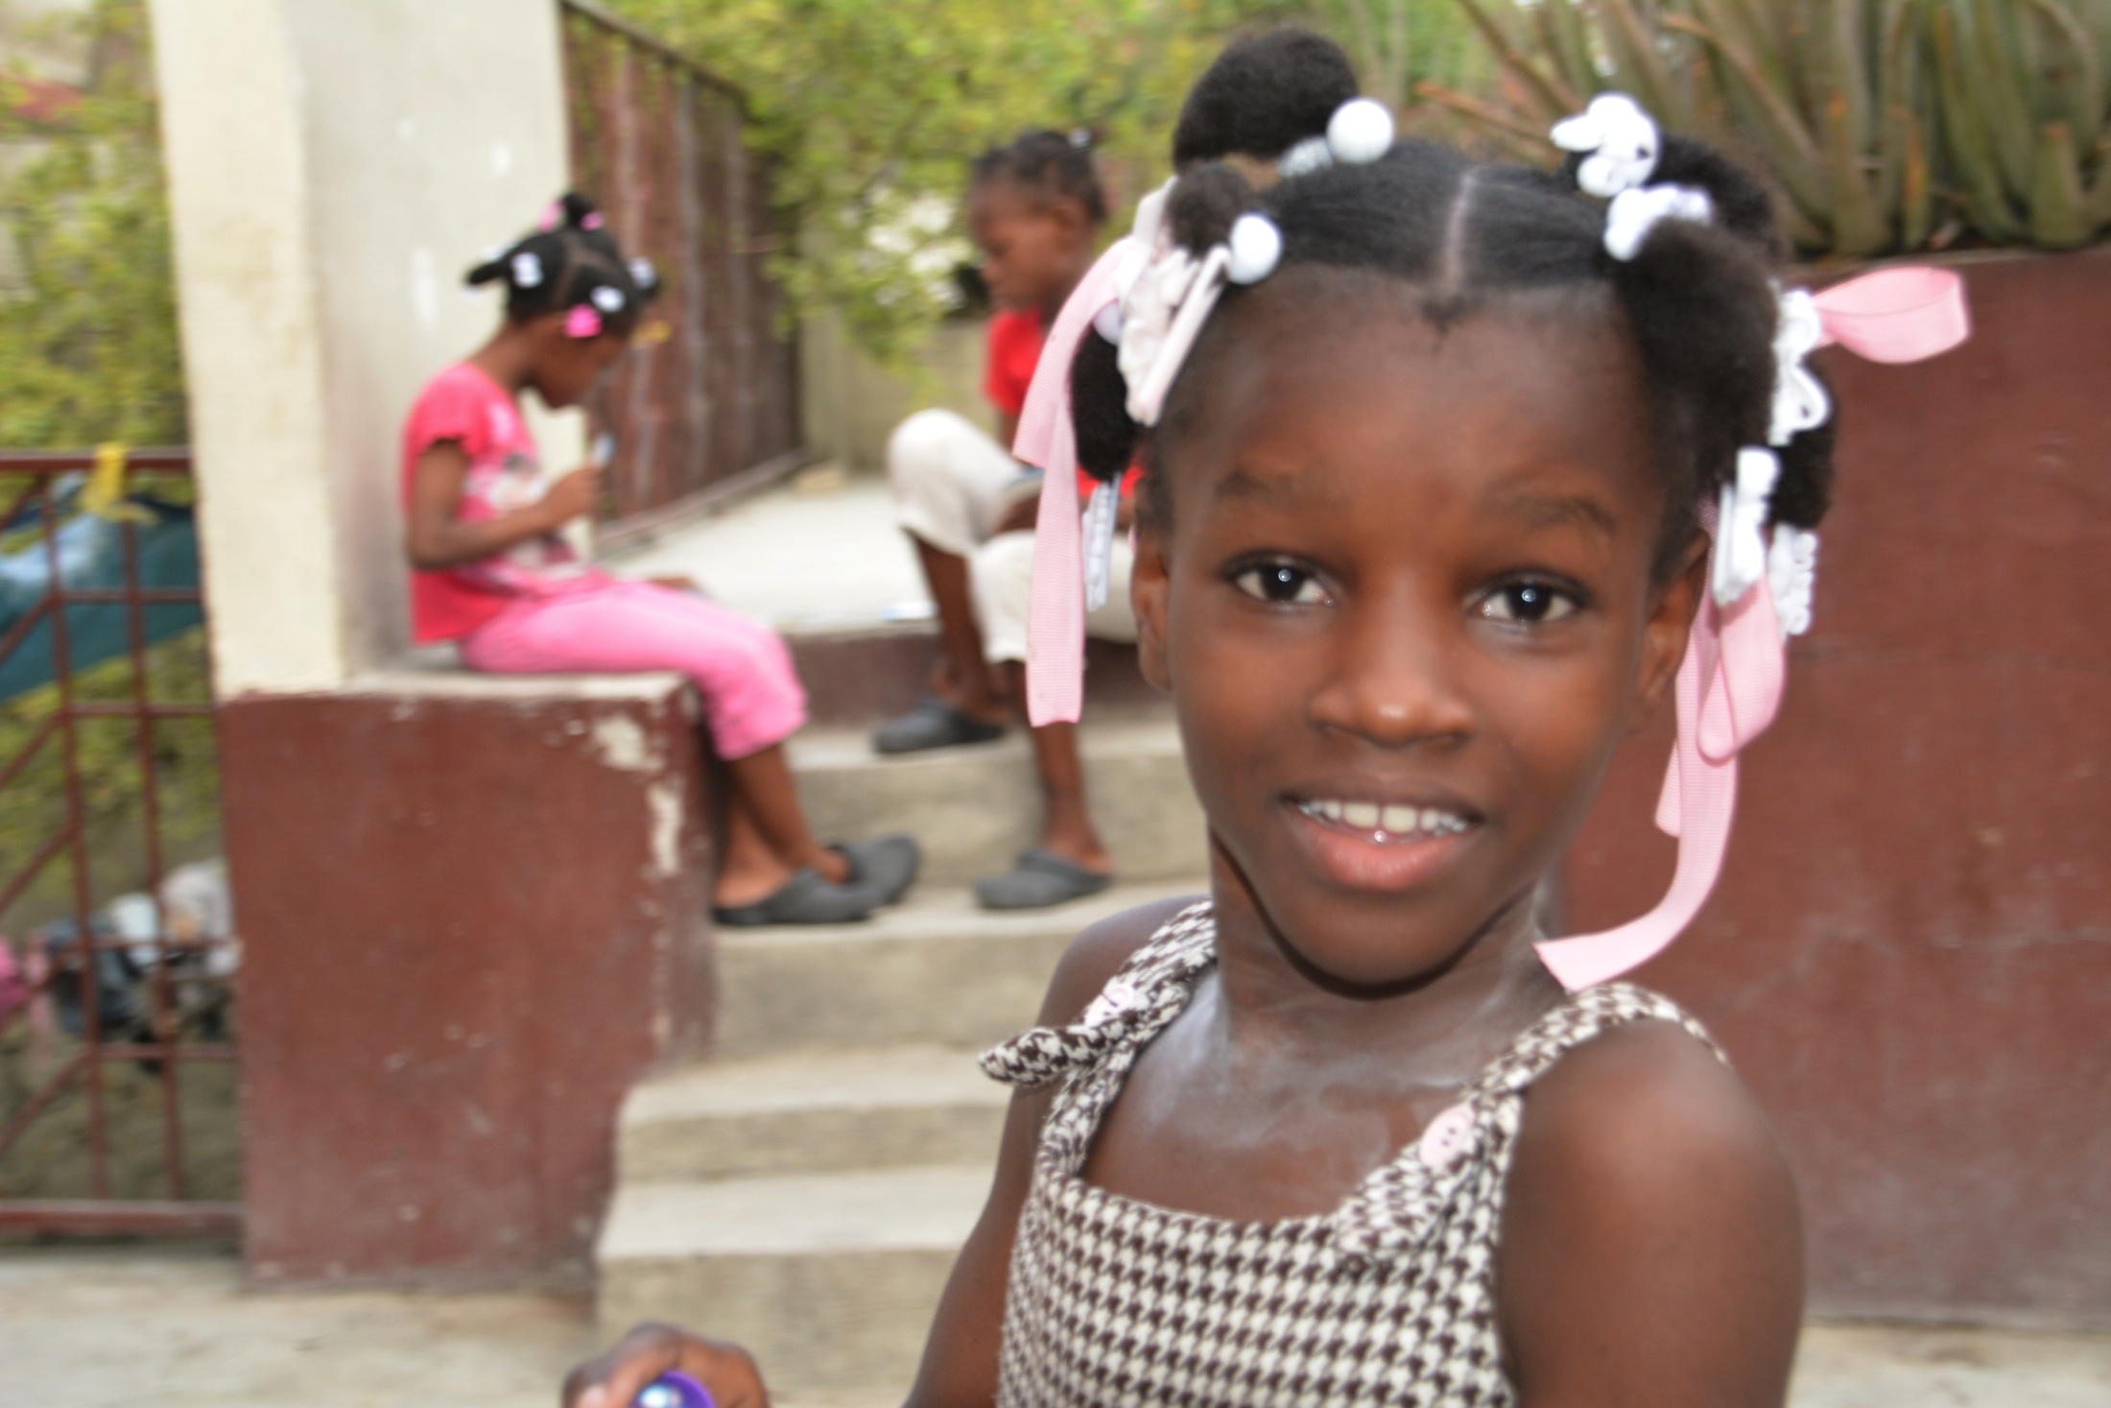
THIS IS where WE 27 girls LIVE!

Slide 7
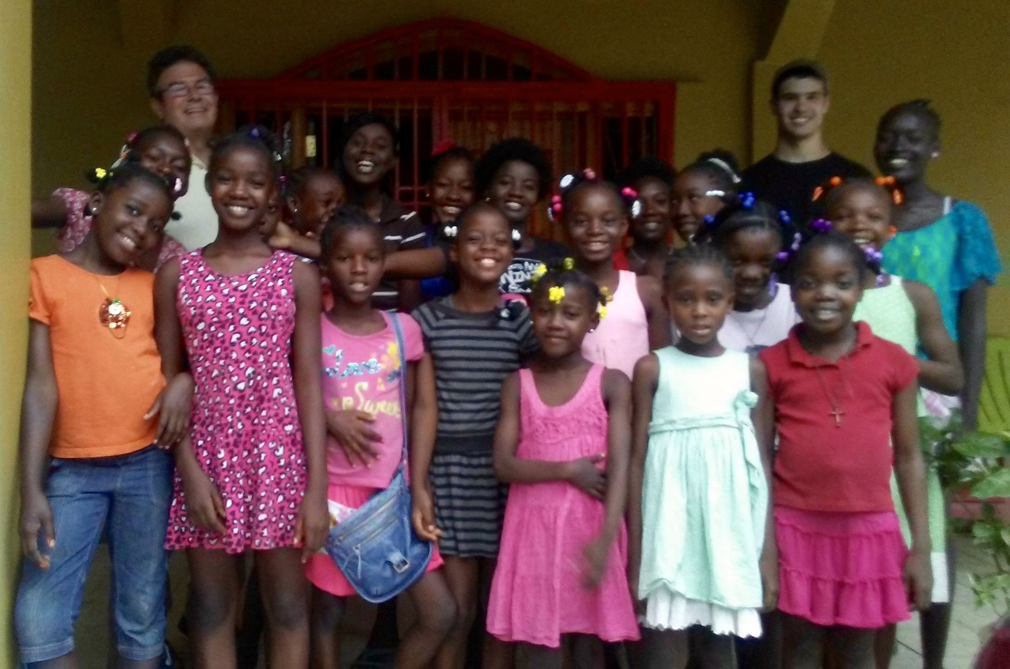
Bruce & The girls

Slide 8
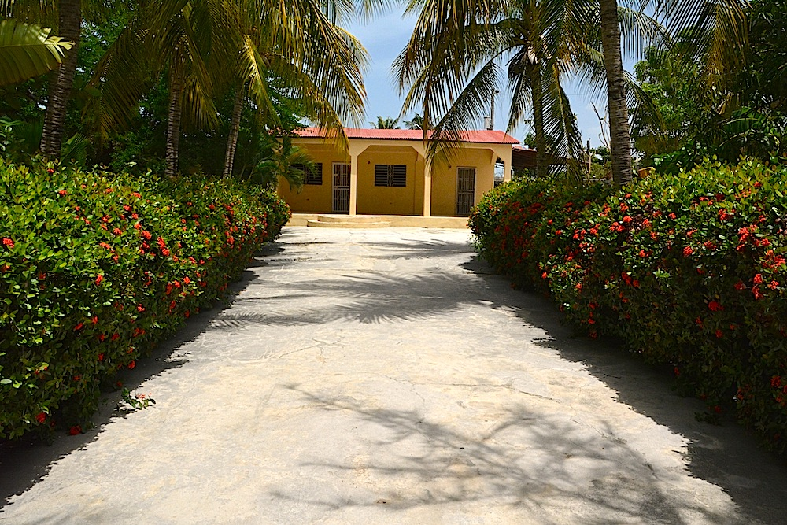
IN OCTOBER, 2014, WE PURCHASED A HOME ON ONE ACRE IN BON REPOS, A RESIDENTIAL AREA IN PORT-AU-PRINCE
The girls call it Chez Moi; that’s French for “My Home.”

Slide 9
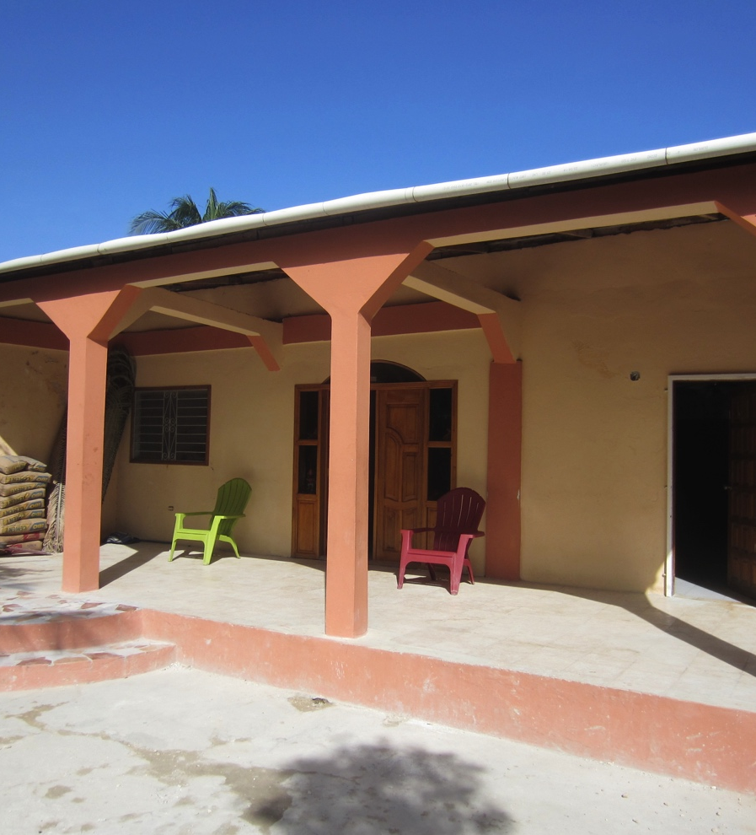
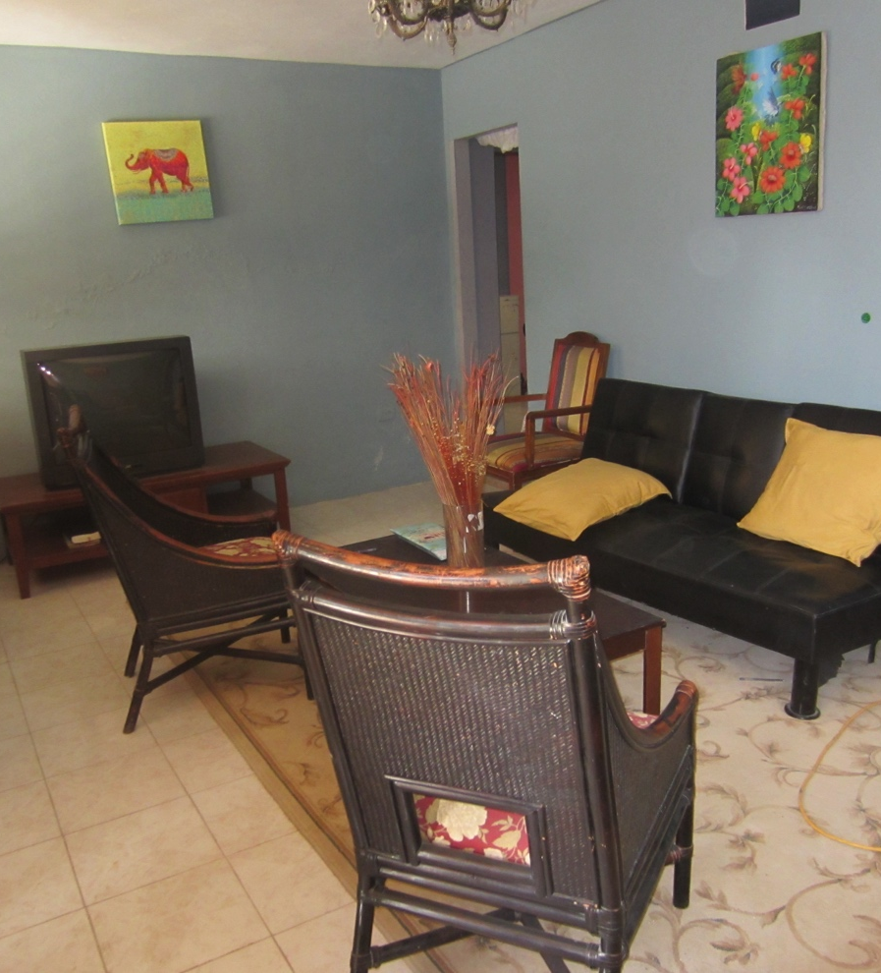
FRONT PORCH, FRONT ROOM

Slide 10
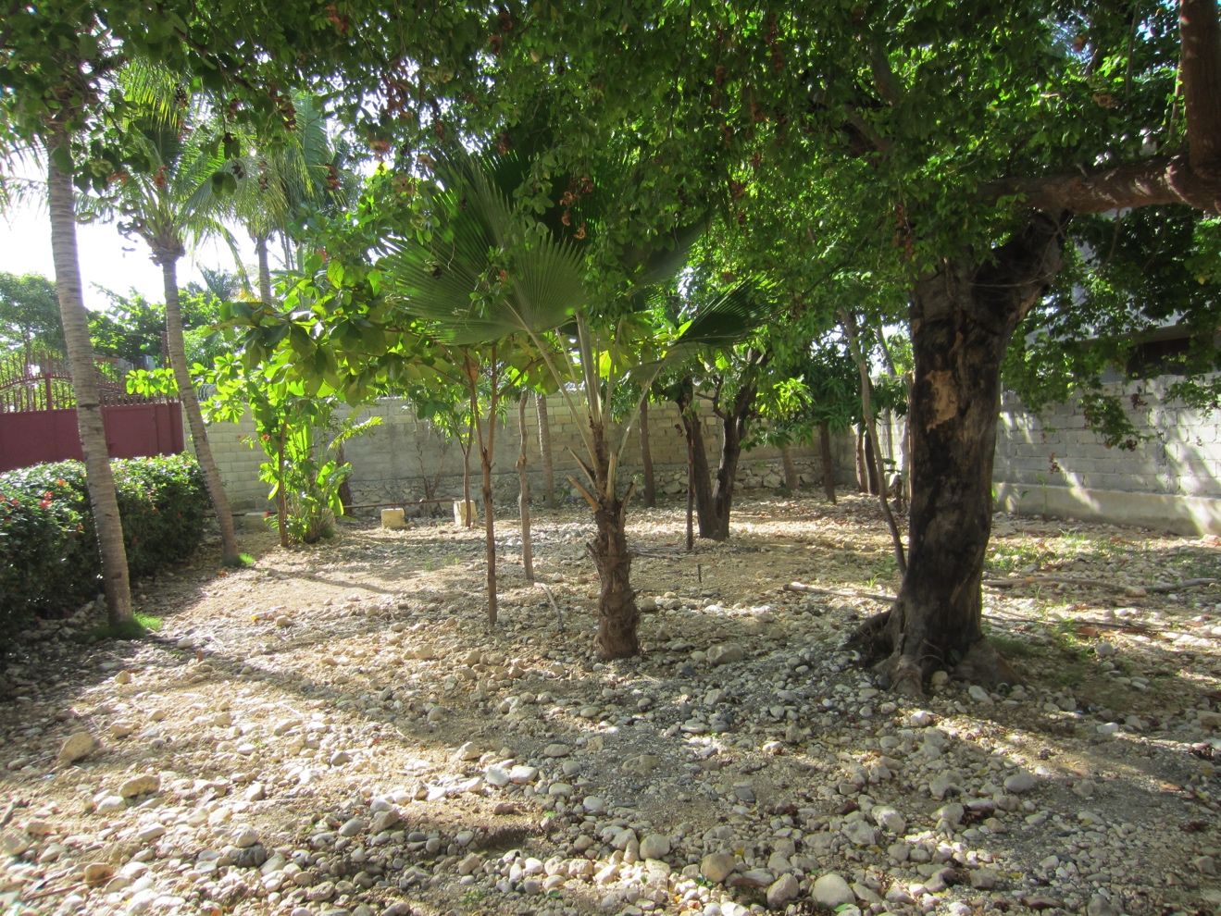
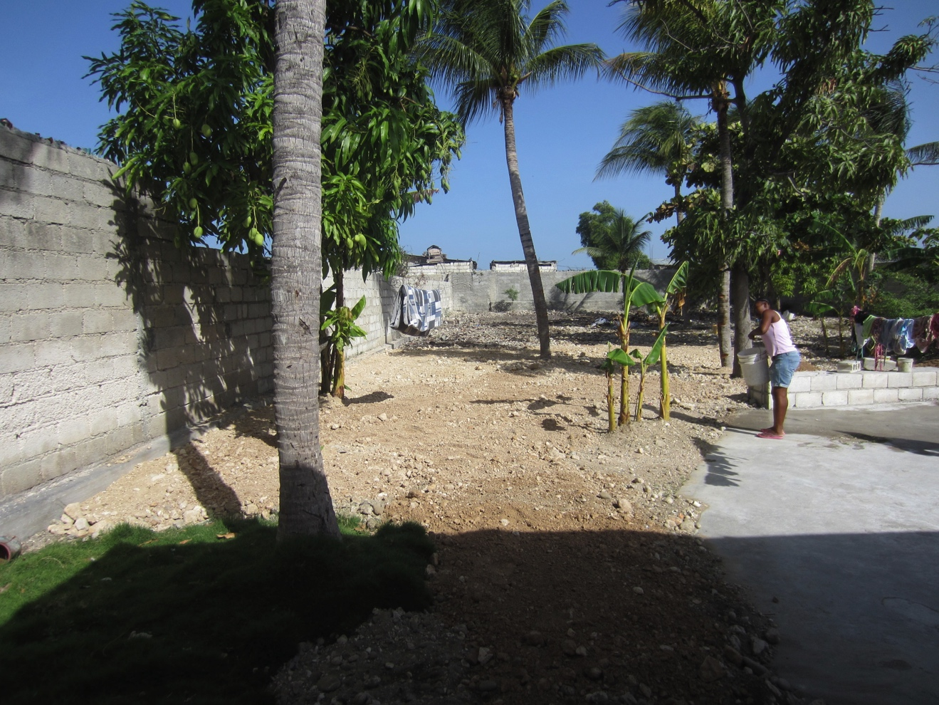
FRONT YARD, BACK YARD

Slide 11
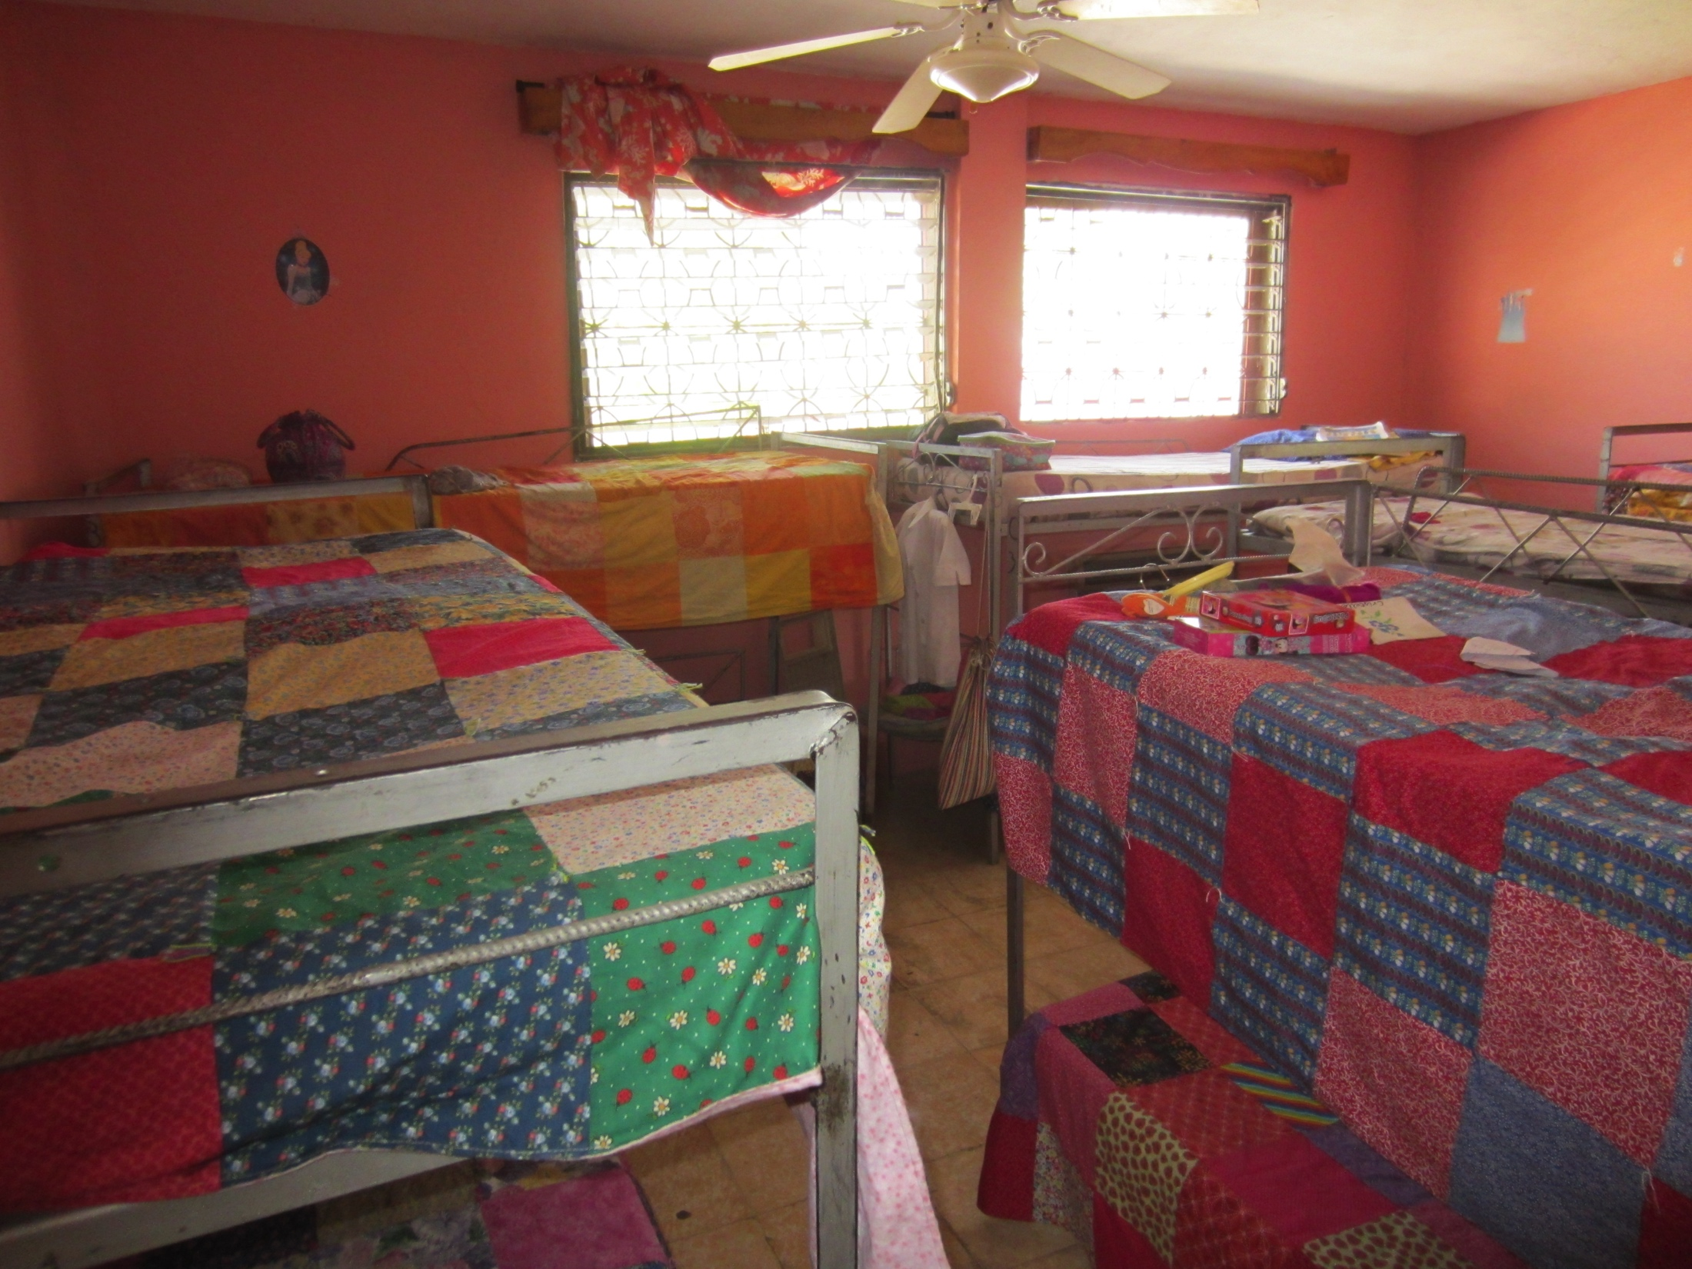
WE SLEEP IN THREE BEDROOMS.

Slide 12
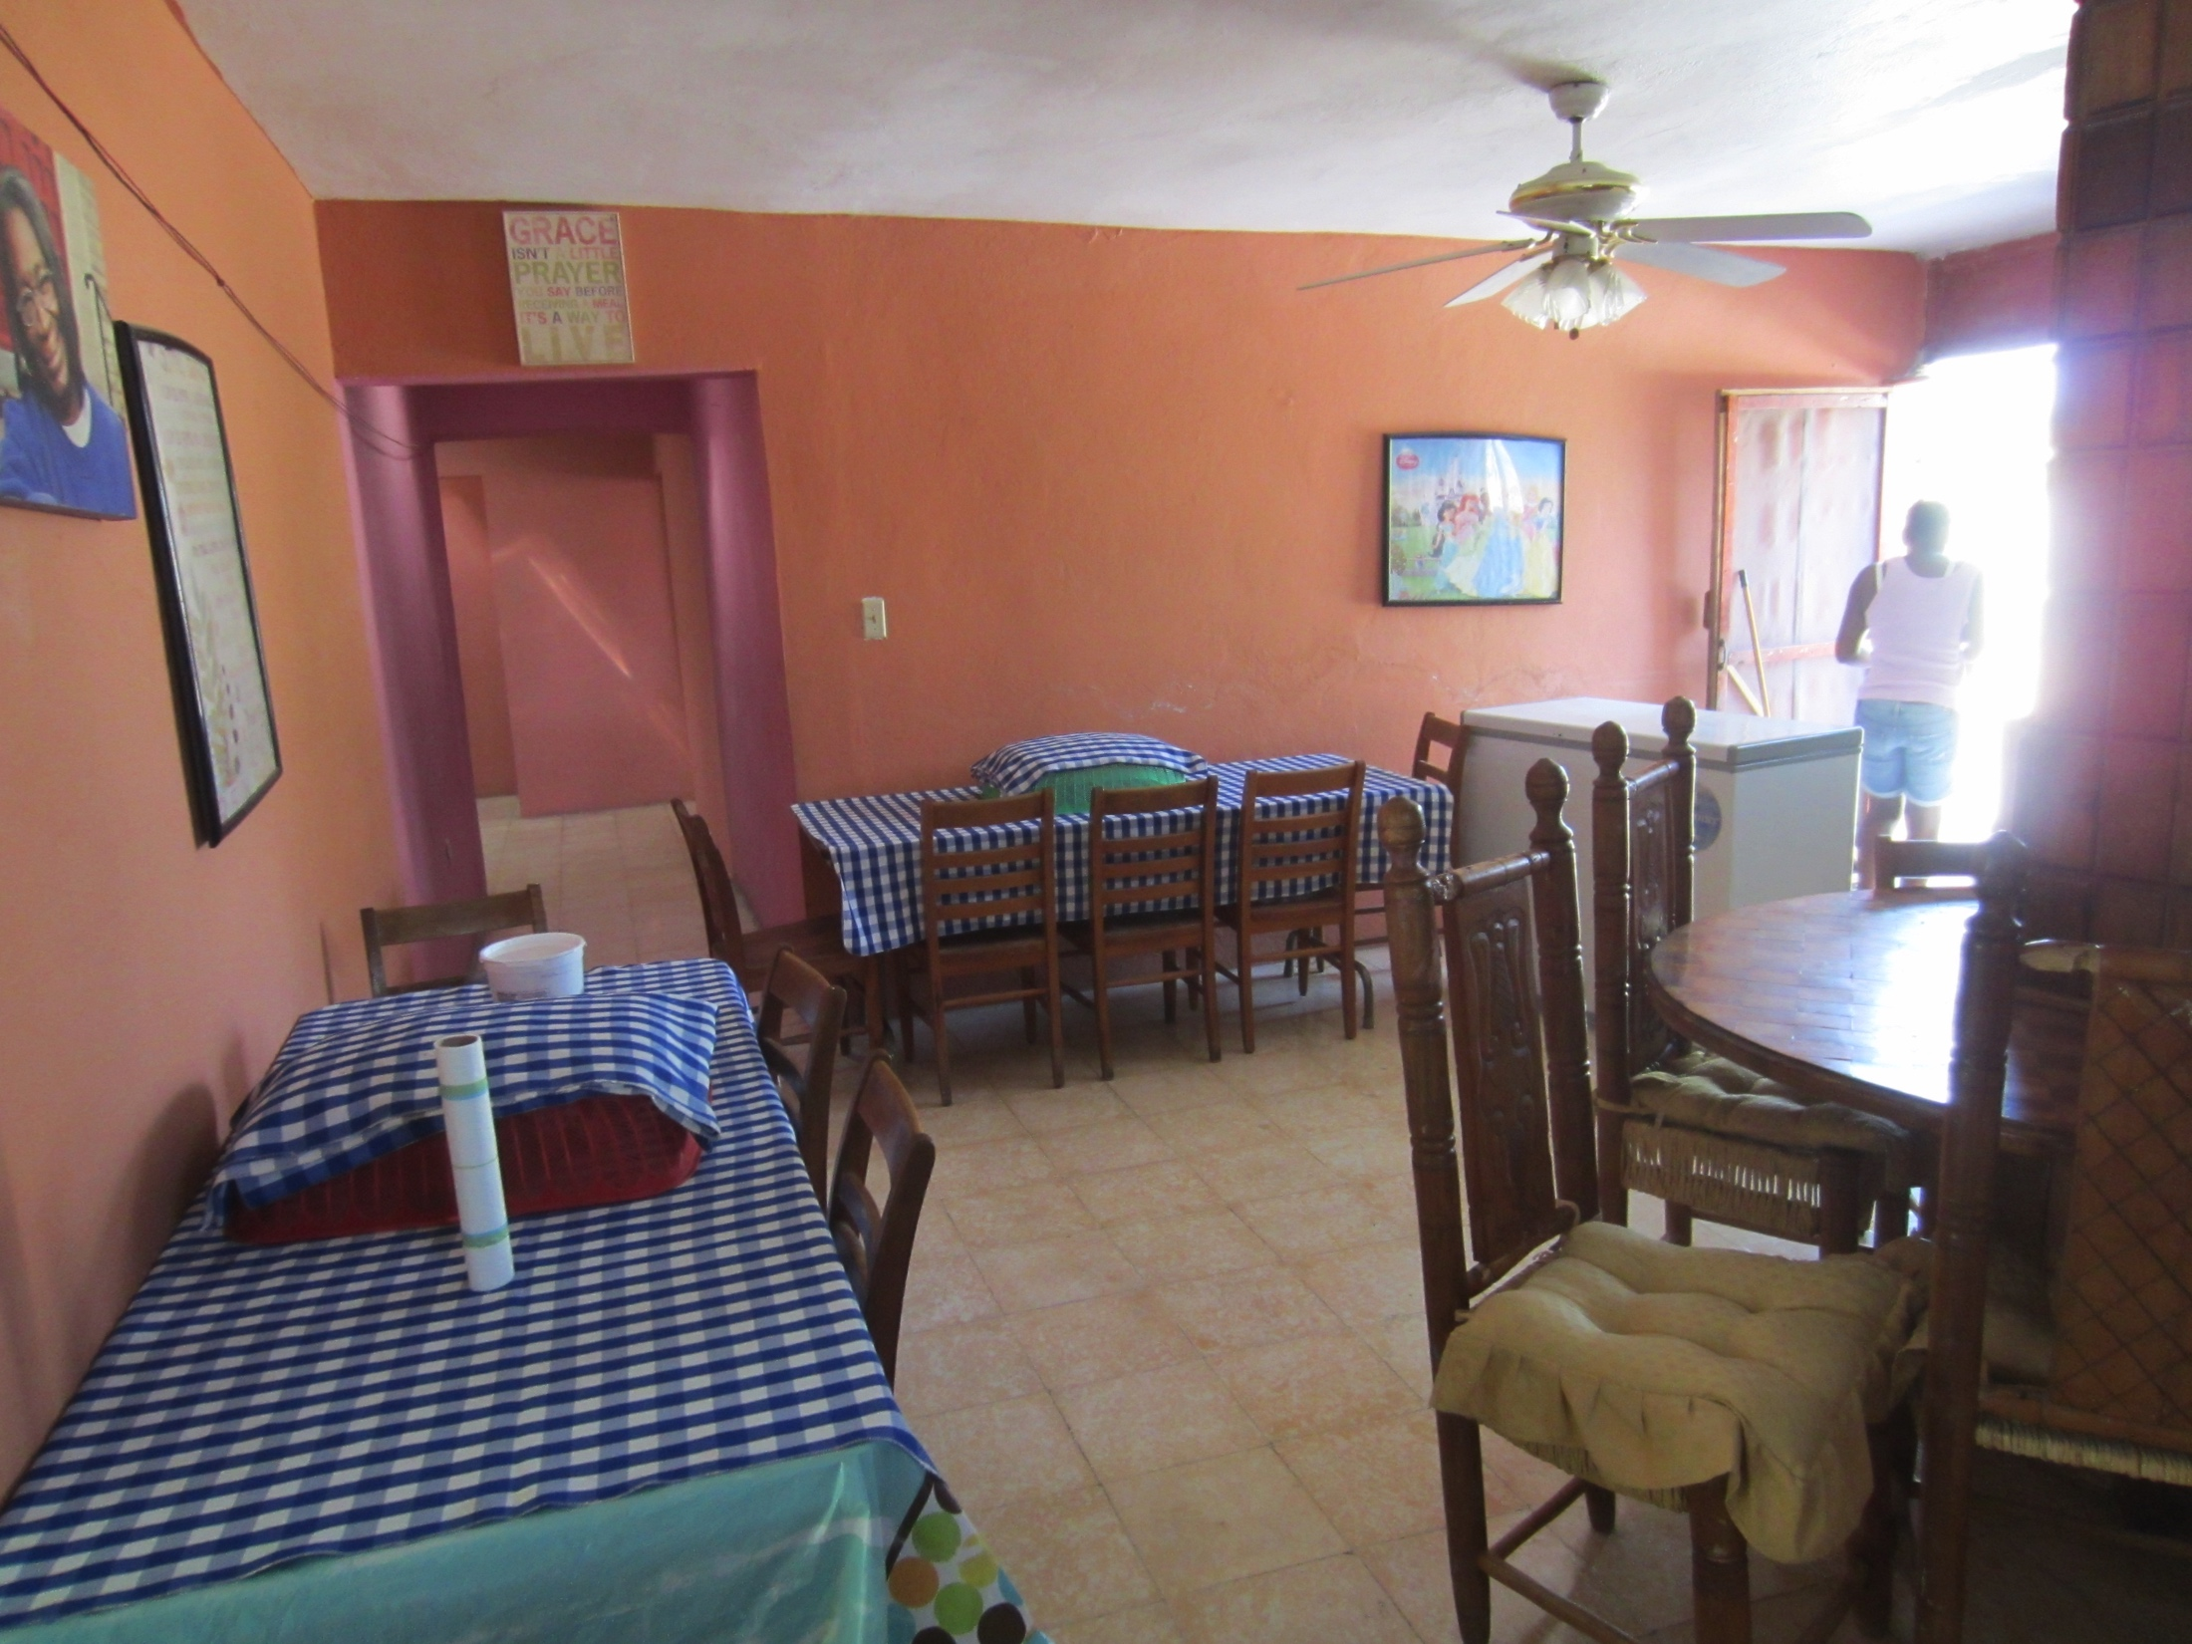
ONE OF TWO DINING AREAS

Slide 13
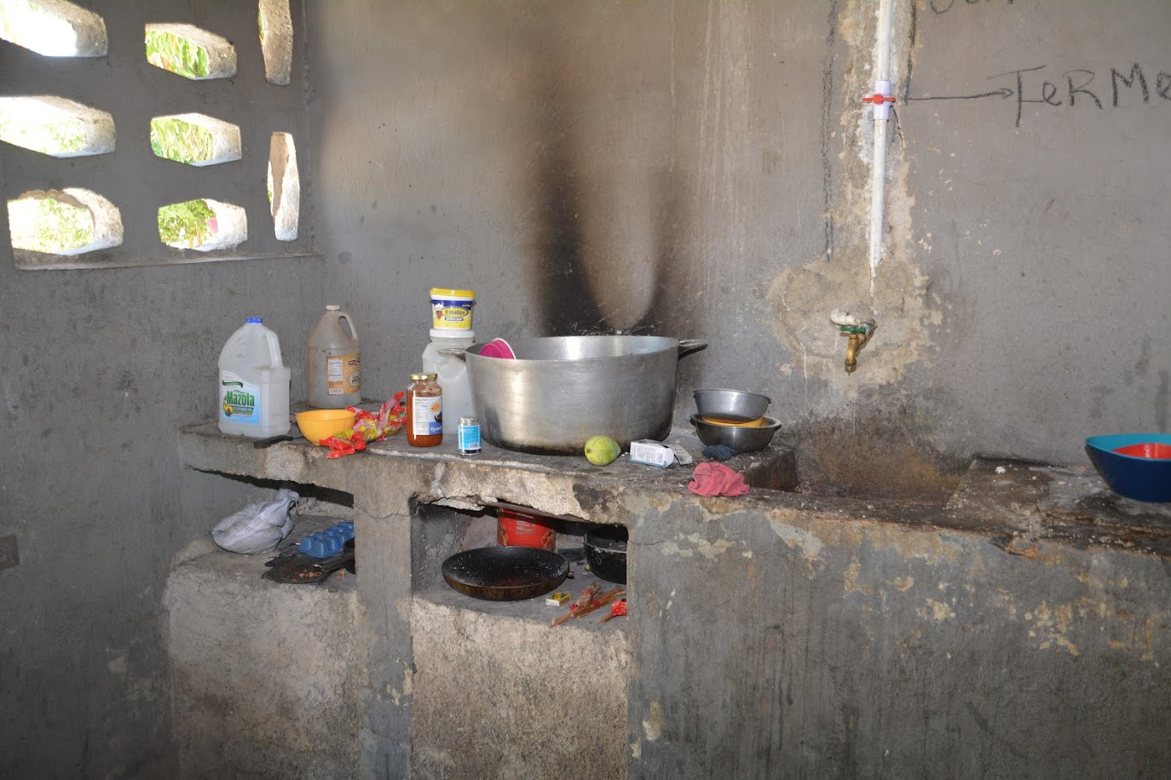
COOKING IS DONE IN A SEPARATE SMALL BUILDING

Slide 14
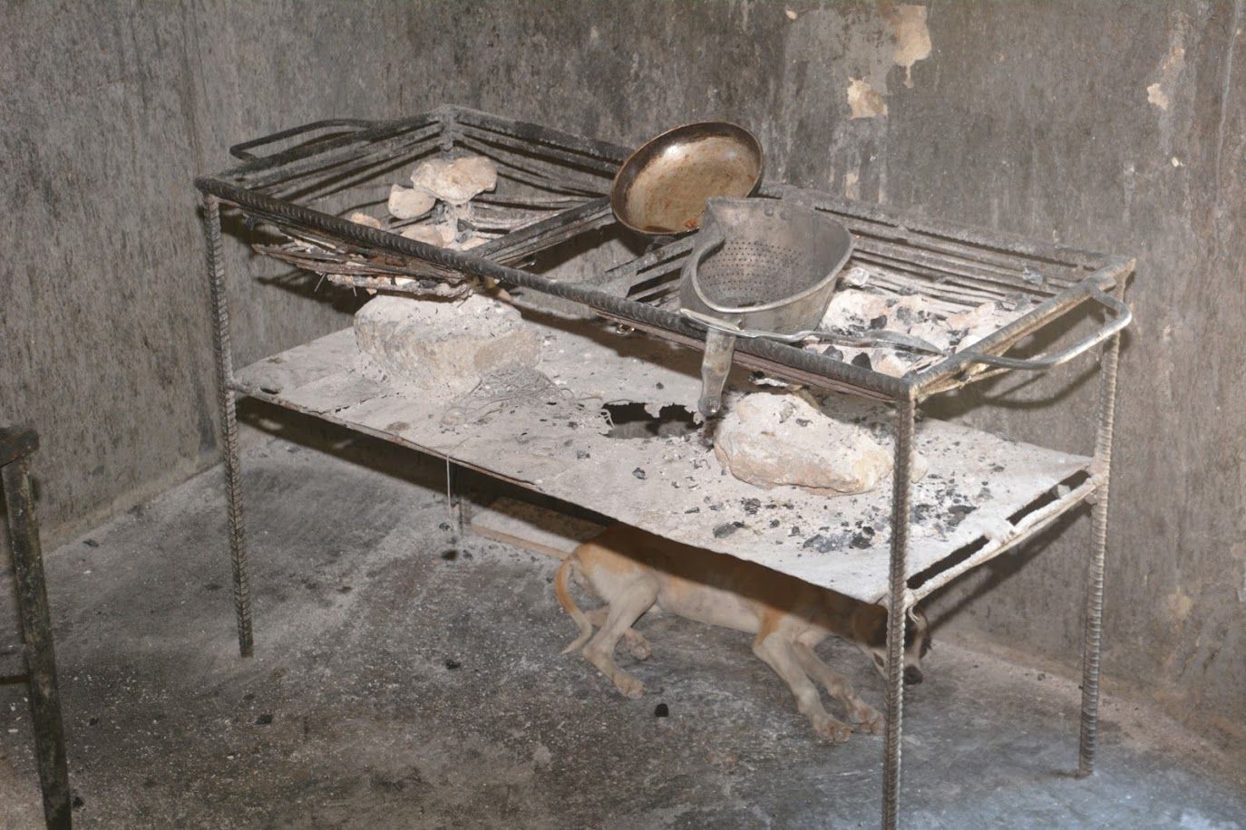
OVER CHARCOAL FIRES

Slide 15
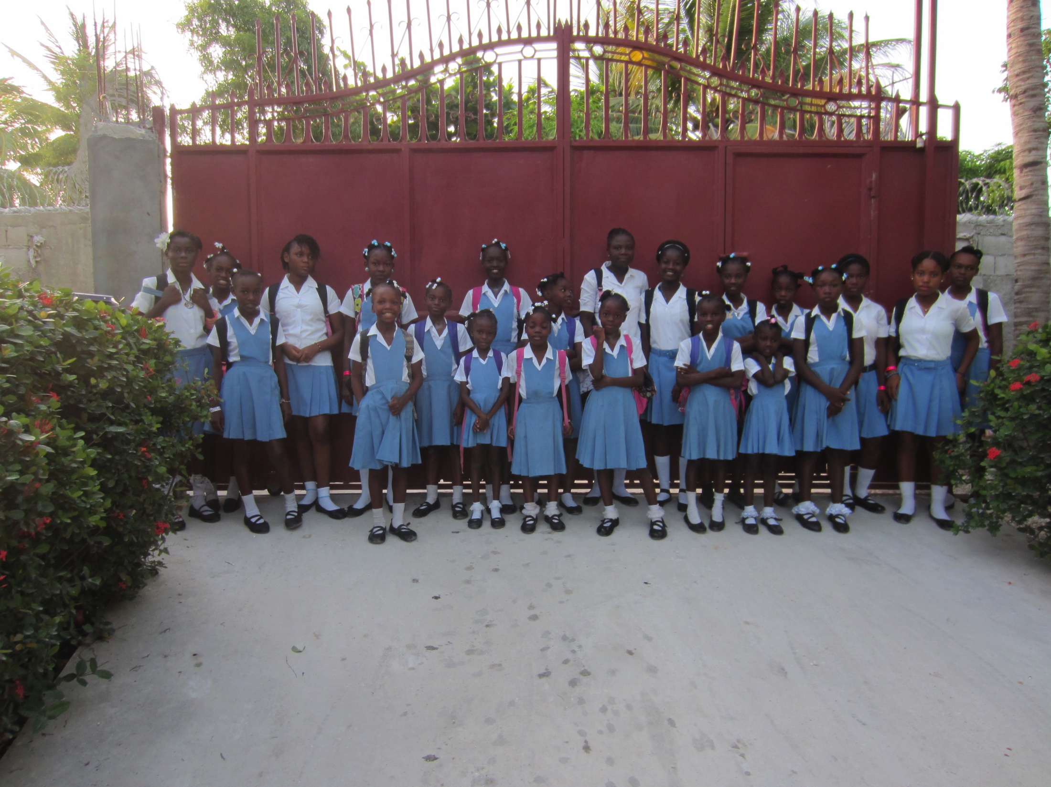
6:30 A.M.
WE ARE READY TO WALK TO SCHOOL.

Slide 16
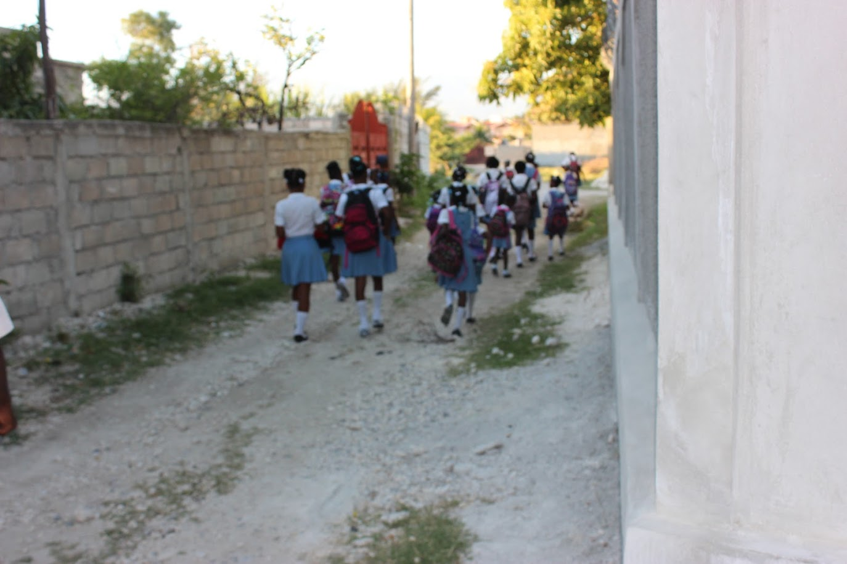
IT’S A TWO-MILE WALK TO AND FROM SCHOOL

Slide 17
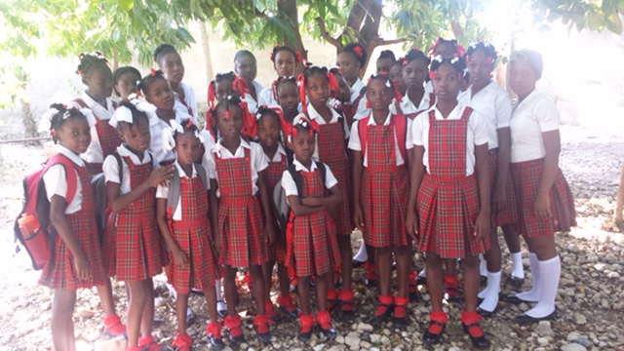
Now we wait on our bus—Yes!!

Slide 18
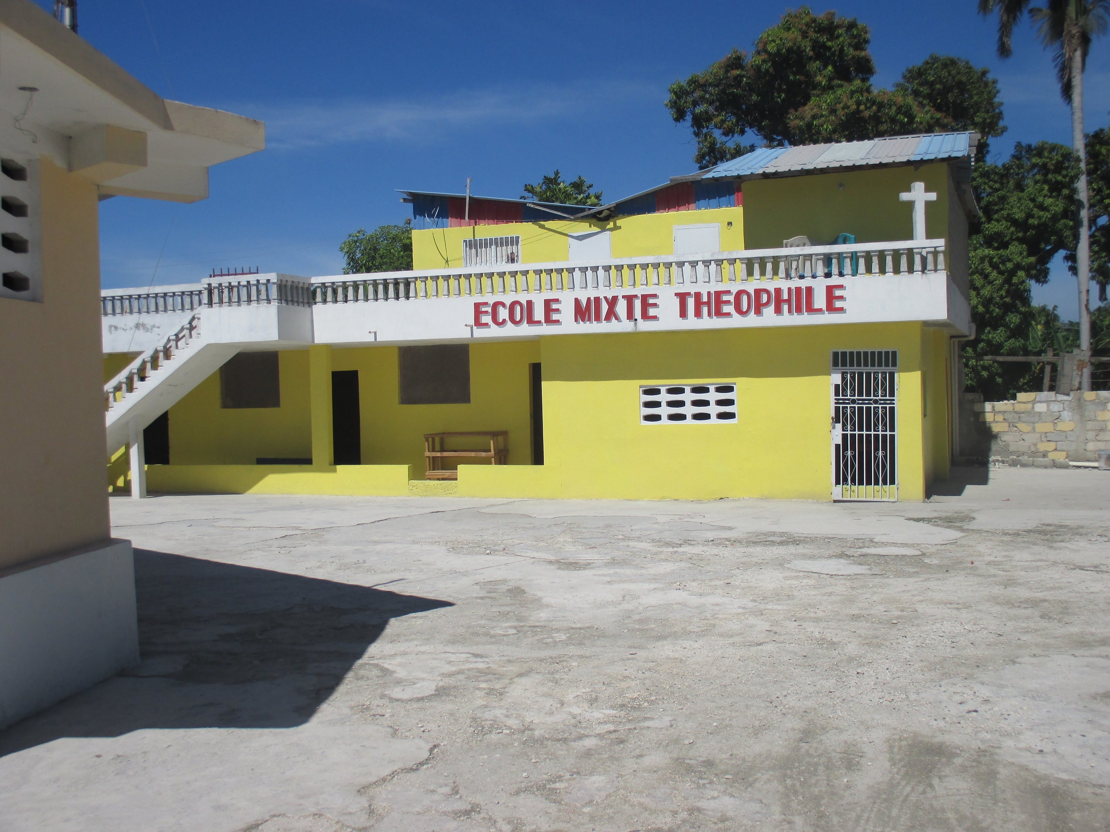
School is the best

Slide 19
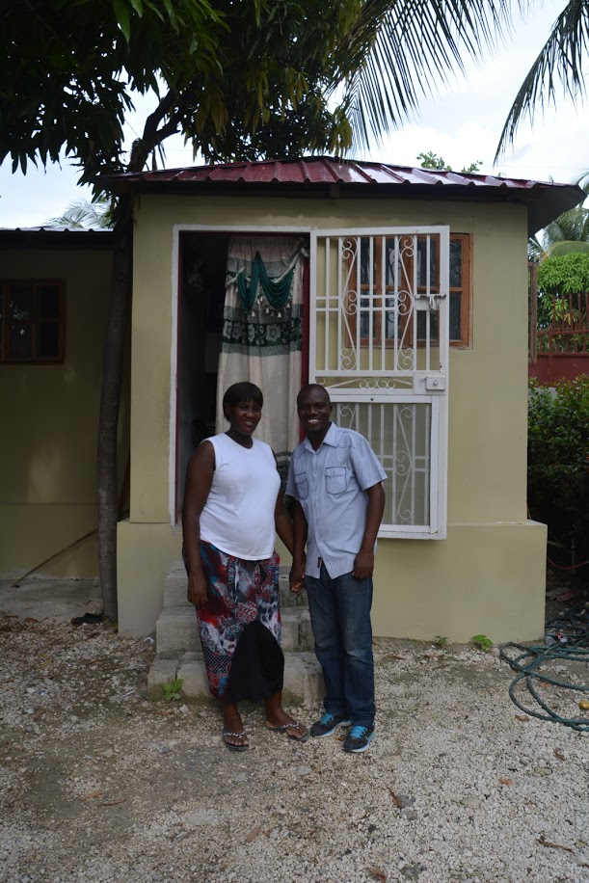
BETANY, OUR HEADMASTER,
AND HIS WIFE LIVE IN A SMALL HOME NEXT TO THE ENTRANCE GATE.

Slide 20
THE NEED
Young Haitian girls are frequently deserted by their families (often single mothers) for lack of resources.^{1,2,3,4}
Chez Moi orphanage is severely overcrowded. A 2,700-square-foot house serves as home to 27 girls (age 5 to 17 years) and three full-time caregivers. More space is desperately needed.
___________________________________________________________________
1. Abandonedchildrensfund.org, Haiti, 2016
2. Save the Children’s 2015, State of the World Mothers Report
3. Americares.org, A Report in Cooperation with the Haitian Health Foundation, 01/27/2014
4. Thehuffingtonpost.com, How are Haiti and Bulgaria the Same?, 02/05/2013

Slide 21
WHAT DOES GRACE MISSIONS, INC DO??
Our Focused Mission
Provide a loving home, clothing, food, medical care and educational access to orphaned or abandoned girls in Haiti.
Primary School
Secondary School
Technical School / College (Some of the best trained minds in Haiti. All will be
prepared to lead Haiti out of the depths of illiteracy, poverty and despair.
Our Future
Alleviate Severe Overcrowding
Increase the Number of Girls to 50
Community-Based Vocational Education
Medical Clinic
Small Business Loans to Women

Slide 22
OUR IMMEDIATE GOAL
Complete Phase I construction of a 2,250-square-foot ground floor structure and a second-floor shell by November, 2017.

Slide 23
CONSTRUCTION PLAN
Phase I Objective (the current proposal)
To nearly double the space for housing girls and caregivers on the existing property.
To allow separation of the girls by age and level of responsibility.
To accommodate Phase II orphanage expansion.

Slide 24
Phase II Objective (a future proposal)
To complete the interior of the second-floor shell and construct a smaller first-floor addition to increase capacity to approximately 50 girls
To renovate the current orphanage building into apartments for elderly women with the objectives of providing (1) additional income to the orphanage and (2) a service to the greater community.

Slide 25
OPERATIONAL SUSTAINABILITY
Average Monthly Income $ 4,800
Monthly Operating Expenses
Staff Cost
Executive Director and member of Grace Missions, Inc.
Board. U.S. Citizen with deep roots in Haiti. Her
Mother founded the orphanage (Ms. Delette Matheus) 300
2 Child Care/Housekeeping/Cooking @ 97 194 1 Nurse 50
1 Social Worker 200 1 Driver (on-call) 35
Mortgage 895
Utilities 115 Food/Clothing 1,300
Transportation 80
Medical 60
Education
English lessons/tutoring 200
Theophile School (Paid quarterly), Monthly Average 450
3,879

Slide 26
INCOME SOURCES
Awaken Church, Lake Wales, FL
Calvary Chapel Sawgrass, Davie, FL
Faith Lutheran Church and their Mission Endowment Trust Fund, Lexington, KY
Grace and Glory Lutheran Church, Goshen, KY
Hope for Haiti, Naples, FL
Kids Against Hunger, Indianapolis, IN
New Bethany Baptist Mission, Dania Beach, FL
Promise Lutheran Church Women’s Missionary League, Murrieta, CA
St. George’s Episcopal Church Centering Prayer Group, Barnesville, GA
St. John Lutheran Church, Griffin, GA
St. Paul’s Lutheran Church, Ladies Aid Society, Indianapolis, IN
Servants of Christ Lutheran Church, Indianapolis, IN
Sixth Avenue Baptist Church, Birmingham, AL
Trinity Episcopal Church, St. Augustine, FL
Zion Lutheran Church and School, New Palestine, IN
Corporate and Organizational Donors
Because I’m Beautiful Girls Club, Inc.
Haiti’s Hope, Inc.
Marriott International
Thirteen girls are sponsored directly by individual donors.
We are also fortunate to have a committed group of consistent individual donors who
believe our work in Haiti is valuable.

Slide 27
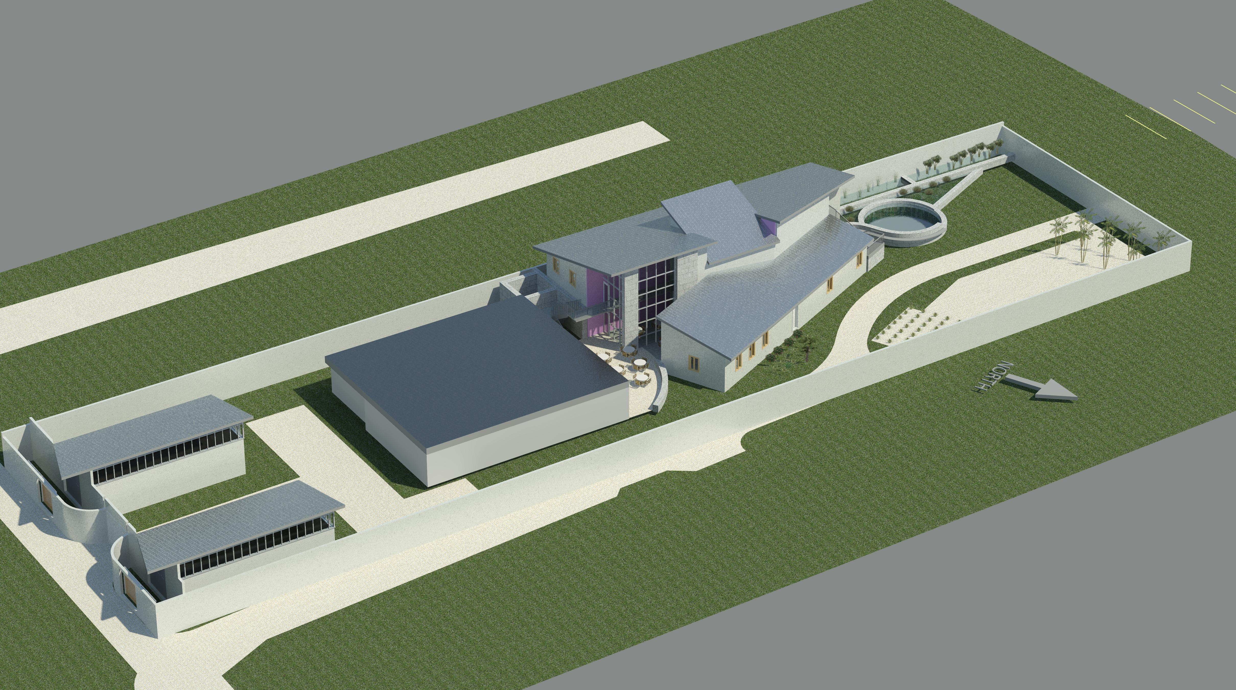
Overview of completed construction

Slide 28
PHASE I: BELOW
PHASE II: ABOVE

Slide 29
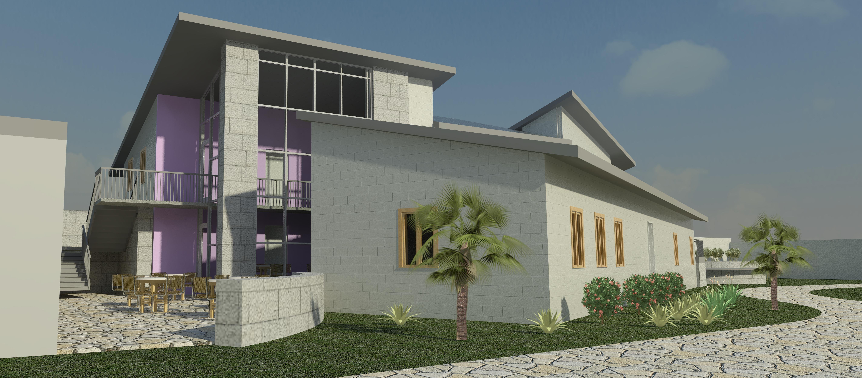
architectural rendition

Slide 30
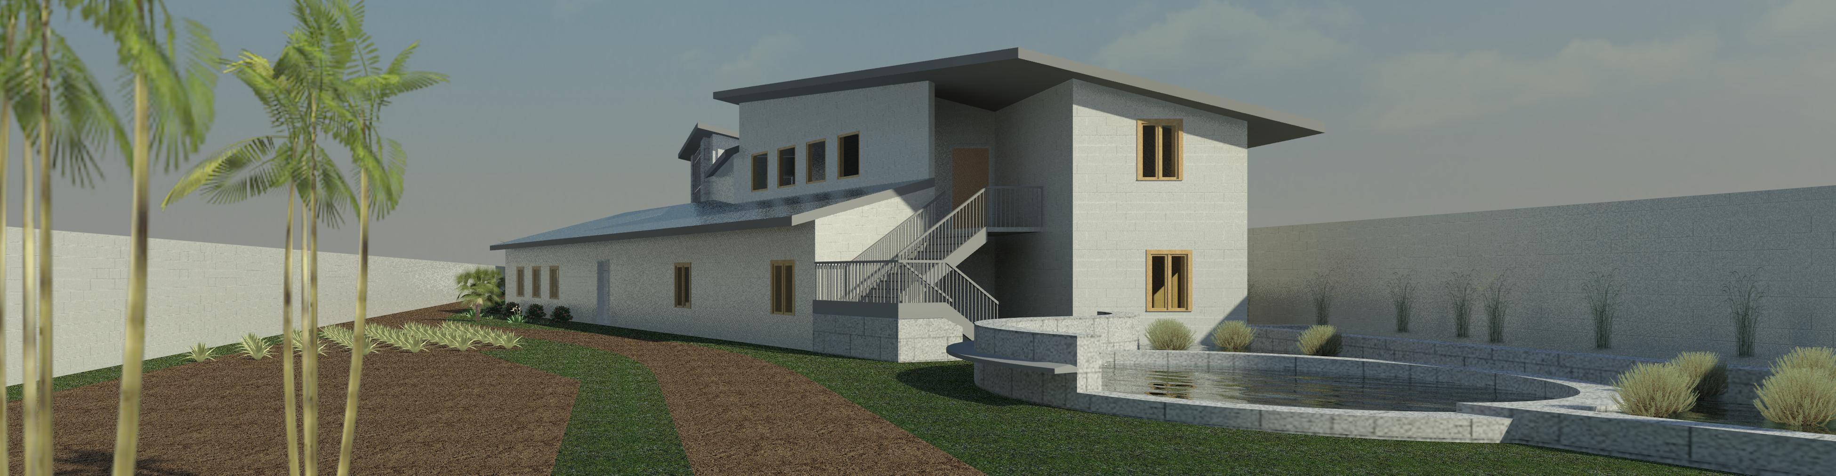
architectural rendition

Slide 31
WILL WE MAKE A LASTING IMPACT ON CAMPUS??
Send Students to Undeveloped Country
Change Frame of Reference / Carry-Back
Develops Correlation Between Design and Use
Research of Prefab and Shipping Containers, etc.
Global University Outreach

Slide 32
UK Led, Interdisciplinary Solutions
Sustainability Council
College of Design
School of Interiors
College of Engineering
Department of Architecture
Graduate Research
Humanitarian

